Slide 1
Mirroring Student Sub-Populations: The Value of Diversity Amongst Mental Health Counselors
MOROLAKE ODETOYINBO, M.S., LMHC
ALETA NIMS, M.A., LMHC
ARAM GOMEZ, M.S., LMHC
CLARKSON UNIVERSITY

Slide 2
Learning Objectives
Participants will discuss ways to be intentional in building an unapologetically diverse counseling center
Identify specific counseling concerns and needs of international students
Learn some considerations in serving young veterans, ROTC students, spouses and children of military families
Better understand the depth of multiculturalism, ethnoracial and socio economic diversity in serving ‘students of color’

Slide 3
Foundational Premise
•College faculty and staff should mirror the student population.
•Building a center that reflects the depth of that diversity is one route to serve students better. As college counseling grows more diverse, that diversity should be reflected in the counseling staff.
•Our strong and confident counseling director leads administratively while the highly experienced assistant director provides clinical supervision to all, including the director.
•We are the most diverse department on campus and celebrate our diversity.
•Our identities and lived experiences play a role in our service delivery.

Slide 4
Clarkson University, Potsdam
•School of Technology in September 1896, 5 men in the preparatory class, 8 men and 4 women in the freshman class
•Dropped all women early on invited back about 80 years later. The first set of women graduated from Clarkson University forty years ago
•Student composition 70:30 male to female undergraduates
•4,300 undergraduate and graduate students from 44 states and 65 countries
•55 study abroad partner universities in 28 countries; co-op opportunities
•Engineering school. Many incredibly book-smart students but
•Potsdam is the ‘heart of the city’

Slide 5
Counseling Concerns and Needs of International Students
MOROLAKE ODETOYINBO, M.S., LMHC
2nd career, global HIV/SRH activist
LGBTQ advocate, adjunct instructor
modetoyinbo@clarkson.edu
315-268-6633

Slide 6
International students
•235 active international students managed through the International Center
•F1 or J1 immigration status, including exchange students, managed directly
•Other international students under different immigration status (Permanent residence, H4) not managed by international center
•Top five countries are China(55), Canada (32), India (24), Iran (20), Sri Lanka (20)
•60 other countries across the globe

Slide 7
Counseling needs
•Loneliness, homesickness and yearning for familiar smells, sights and sounds
•Mindful of the nuances of multi lingual, ethno-racial identities, socio economic diversity of internationals
•Culture shock, challenges of transition and assimilation
•Understanding the needs of LGBTQ and non gender conforming students – searching for acceptance living two (double) lives
•Learning a new ‘language’ and understanding nuances
•Academic and classroom experiences
•Struggles with imposter syndrome and the effect of code switching on self esteem

Slide 8
Counseling needs
•Effect of code switching on self esteem and academic performance
•American-born international
•International American student (children of recent immigrants)
•Global economies and growing cost of foreign exchange affects the cost of tuition and school security
•Inability to travel, need to stay on campus during breaks and holidays
•Living in a PWI as part of a non-dominant groups
•Vulnerable to abuse but reporting is low
•Restrictions navigating and negotiating safety and trust

Slide 9
Practical concerns
•Work opportunities- internships and coops
•Visa renewals there are no US embassies in America.
• I-20s are college specific
•Celebrating significant religious or national holidays
•SSN = Freedom
•Rates of abuse is high and reporting is low
•Restrictions navigating and negotiating safety and trust
•Student Health Insurance Plan provides limited coverage and routine wellness checks- doesn’t include mental healthcare, dental and vision care
•Chronic illnesses like sickle cell anemia, HIV infection type 2 diabetes aren’t covered
•Post graduation OPT is 12 months for most people. Most licensures takes longer

Slide 10
Note to therapists
•I might be well trained, confident and comfortable working with any sub population, but expecting that anyone should be comfortable coming to me is presumptuous.
•Be mindful of the nuances of multi lingual, ethno-racial identities, socio economic diversity of internationals
•Counselors who look like me
•Service should be client-centered
•Value self-exploration and
•Our identities and lived experiences play a role in counseling service provision

Slide 11
Recommendations
•Understand race and politics
•Counseling centers must be willing to take the risk of hiring qualified candidates who might not have the clinic experience, and provide supervision and support through licensure and beyond
•Ask questions from other departments, go in to learn and provide support
•Acknowledge and celebrate your strengths and diversity

Slide 12
Serving Veterans, ROTC Students and Children or Spouses of Military Families
Aleta Nims, MA, LMHC NCC
Director of Counseling at Clarkson University
Veteran: Former Air Force Navigator on a C130 (O3-Captain)- 7.5 years on active duty
Current military spouse (14 years) and mother of 2 BRATS (ages 12 and 8)
anims@clarkson.edu 315-268-6633
Objective:
Participants will learn some considerations in serving veterans, ROTC students and children or spouses of military families

Slide 13
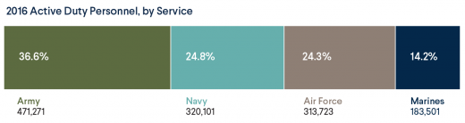
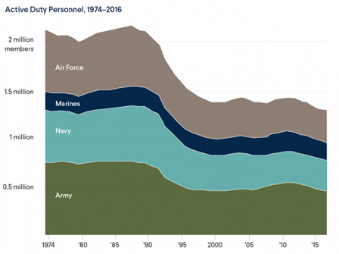
Who ARE our military?
Currently 1.29 million service members or less than 0.5% of the US population

Slide 14
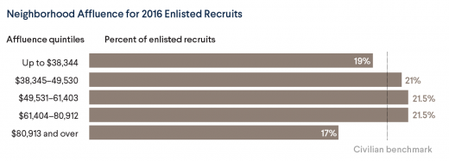
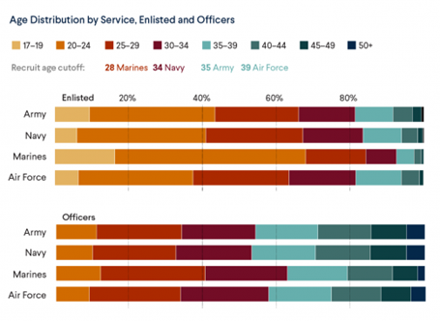
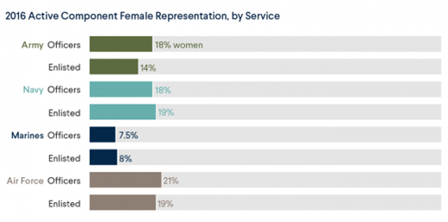
Who ARE our military?

Slide 15
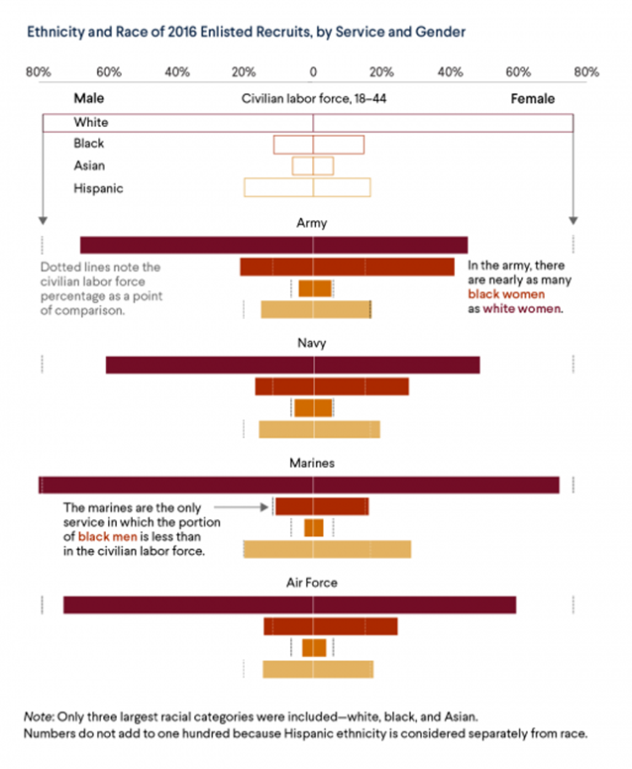
Who ARE our military?

Slide 16
Branches of the Military
Army (14 Jun 1775)
Soldiers who live on forts or posts- long deployments 9+ months “Hooah!”
Navy (13 Oct 1775)
Sailors who live on bases- deploy to sea for 6-9 months at a time “Hooyah!”
Marines (10 Nov 1775)
Marines who live on installations/bases- deploy for 12+ months “Oorah!” “Semper Fidelis (Fi)”
Coast Guard (04 Aug 1790)
“Coasties” who live on installations/bases- can deploy but not as common- operates under the US Department of Homeland Security during times of peace. "You have to go out, but you don't have to come back!"
Air Force (01 Aug 1907 (part of Army) 18 Sept 1947 (independent branch))-
Airmen who live on bases, deployments 4-12 months “Hooah!”
Active Duty vs National Guard vs Reserves
Command structure differences- Federal vs State- Governor vs. President (Little Rock Nine)
Guard and Reserves deploy more now than before OIF/OEF but typically don’t PCS
Differences in culture and military family dynamics

Slide 17
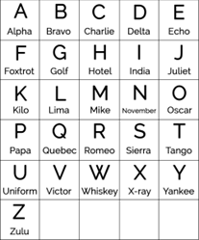
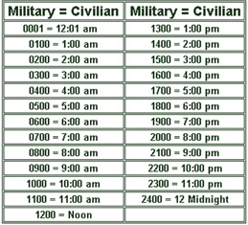
Military Culture
Warrior ethos- Don’t want to appear weak- stigma is real
Failure is not an option.
Pain is just weakness leaving the body.
You sleep when you die.
If the service wanted you to have a family, they would have issued you one.
Military Alphabet: Telling Military Time:

Slide 18
The language of the military: ACRONYMS!!!
PCS | Permanent Change of Station | relocation- move
TDY | Temporary Duty Station | up to 6 months
OIF | Operation Iraqi Freedom | 20 March 2003- 18 December 2011
OEF | Operation Enduring Freedom Operation Freedom’s Sentinel | 7 October 2001-28 December 2014 ongoing to present day
DOD | Department of Defense | part of U.S. government responsible for military operations.
MOS | Military Occupational Specialty | what your specific job is
OPSEC | Operational Security | protecting info about military operations
PT | Physical Training | must meet fitness standards throughout enlistment
PX/BX/NEX/MCX | Post/Base/Naval/MC Exchange | shopping mall- shelf check!
POC | Point of Contact | person you contact about a specific program or assignment
BAH | Basic Housing Allowance | pay for when base housing is not available
CONUS OCONUS | Continental Unites States Outside the Continental US | 48 connected states outside the 48 connected states
LES | Leave and Earning Statement | leave balance, pay, withholdings, allotments
DITY | Do It Yourself move | when you move your own household
CO | Commanding Officer | person in charge
NCO | Non-Commissioned Officer | officer who has not received a commission, such as sergeant (Army) and warrant officer (Navy)
TRICARE | Military health care program | TRICARE provides health benefits to service members, retirees and their families

Slide 19
Mental Health and Our Service Members
30 percent of active duty and reserve military personnel deployed in Iraq and Afghanistan have a mental health condition requiring treatment – approximately 730,000 men and women, with many experiencing post-traumatic stress disorder (PTSD) and major depression.
Less than 50 percent of returning veterans in need receive any mental health treatment.
The Veterans Administration reports that approximately 22 veterans die by suicide every day.
Lengths of deployments are associated with more emotional difficulties among military children and more mental health problems among U.S. Army wives.
Do:
Ask specifically about deployment, combat, and trauma experience.
Ask specifically about suicidal ideations.
Ask female service members about sexual harassment (80%) and assault (30%).
Assess for stressors- drugs/alcohol, financial, relationship- anger, infidelity.
Don’t:
Assume all military members are the same or had the same experiences.
Assume PTSD or combat exposure.
Be afraid to use humor.

Slide 20
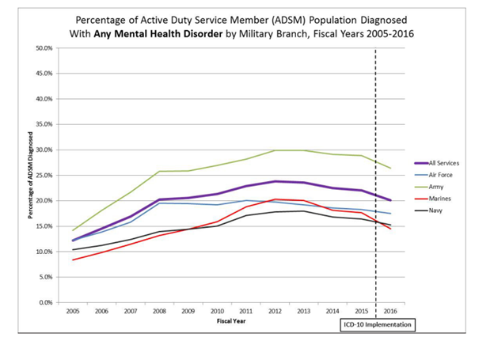
Mental Health and Our Service Members

Slide 21
Serving the Military Spouse
As of 2017 there were 641,639 military spouses
95% women
Resilient- running a household, holding a career/pursuing education(85%), reinventing themselves at every move- can feel lonely and high pressure
“Handbooks” of military customs and etiquette- no formal training
Underappreciated and sometimes feel invisible
Unemployed or Underemployed (self-reported 90%)
Creative approaches- independent- sacrificing
Wives/Spouses Clubs- double edged sword?
“We constantly seek out other military spouses for networking and friendship and use social media at a much higher rate than the general population. At least one-third of military spouses have considered starting or have attempted to start their own business. Moreover, according to the Blue Star Families Military Families Lifestyle Survey, we volunteer at a rate more than three times the national average, often taking leadership roles in both military and community institutions.”
“You have to be tolerant. You have to be flexible. You have to be resilient. You have to be extroverted, or at least sociable enough to fool all the pools of new people you're thrown in with on a regular basis. You have to be willing to make sacrifices to your career —because fulfilling, military-spouse-proof, work-from-home jobs don't grow on trees (whatever Susan's pyramid scheme would have you believe). You have to be capable enough to manage a household single-handedly, but humble enough to be sidelined in social situations.”

Slide 22
Serving the Military Brat
15 million Americans are current or former brats
Wear the term as a badge of honor
Even more invisible to the larger culture than spouses
Move every 2-3 years
Adaptable, outgoing, worldly, high social skills, service to others
Avoidant of problems, feel like outsiders, lack deep relationships- but lower divorce rates
“Home Is Where the Army Takes You”
Difficult questions to answer: Where is home? Where are you from?
Life on Base:
“A military base or post is a community within a community. It’s fenced off from the civilian world around it- a sanctuary for military families filled with amenities that make on-base living pretty pleasant. On base, you’ll find gyms, pools, bowling alleys, sports fields,restaurants, military housing and barracks, golf courses, walking trails, schools, grocery stores, shooting ranges, and lots more.”

Slide 23
Serving the Military Brat
· Because military brats are constantly making new friends to replace the ones that they have lost, they are often more outgoing and independent.
· On the other hand, the experience of being a constant stranger can lead them to feel estranged everywhere, even if later in life they settle down in one place.
· Grown military children are very monogamous. When they marry, it is generally for life; over two-thirds over age 40 are married to their first spouse.
· Military children are more likely to have a college degree and are more likely to have an advanced degree.
· Often mirror the values, ideals, and attitudes of their parents more closely than children of civilians.
· More emotional struggles when compared with national examples- worse with deployments. Higher levels of anxiety, depression and withdrawal.
· More disciplined than civilian peers.
· The perception that the country supports the wars their parents deploy to fight has a positive effect on the mental health of military children.
· Under constant pressure to conform to what military culture expects; sometimes this is perceived as being more mature, even if its only their outward behavior.
· Some develop psychological problems due to the intense stress of always being on their best behavior= increased perfectionism traits.
· The bonds connecting military communities are normally considered stronger than the differences of race. Grow up in a setting that actively condemns racist comments. The result is a culture of anti-racism.
· In studies, 80% of military children claim that they can relate to anyone, regardless of differences such as race, ethnicity, religion, or nationality.

Slide 24

References/Resources
https://www.ncfr.org/ncfr-report/focus/military-families/advice-therapists
https://www.pdhealth.mil/sites/default/files/images/mental-health-disorder-prevalence-among-active-duty-service-members-508.pdf
https://www.militaryonesource.mil/military-life-cycle/friends-extended-family/common-military-acronyms
https://www.cfr.org/article/demographics-us-military
https://www.insider.com/military-spouse-what-is-it-like-2018-5
https://themilitarywifeandmom.com/manners-for-milspouses-12-must-know-etiquette-rules-of-military-life/
https://www.uschamberfoundation.org/bhq/evolution-military-spouse
https://foxtrotalpha.jalopnik.com/what-its-like-growing-up-as-a-military-brat-1722058525
https://www.wearethemighty.com/articles/20-important-facts-about-military-brats-backed-up-by-research

Slide 25
Multiculturalism, Ethnoracial and Socio Economic Diversity in Serving ‘Students of Color’
ARAM GOMEZ, M.S., LMHC
Counselor at Clarkson University
Member of the Association of Multicultural Counseling and Development (AMCD)
Former facilitator for the Institutes for the Healing of Racism (Rutstein, N., Amherst, MA)
Previous cognitive psychology research involving Stereotype Threat
agomez@clarkson.edu 315-268-6633
Objective:
Participants will better understand the depth of multiculturalism, ethnoracial, and socioeconomic diversity in serving students of color.

Slide 26
Students of Color?
Students of Color (SOC) - used to refer to any student who may identify as being part of a non-white racial identity group such as Black, African-American, Asian, South Asian, Middle Eastern, Pacific Islander, Latinx, Chicanx, Native American, and multiracial.
(Adapted from Race and Pedagogy, University of Wisconsin-Madison)
Students of color make up more than 45 percent of the undergraduate population, compared with less than 30 percent two decades ago - 32 percent of graduate students were students of color - Hispanic population shows the most growth in higher education - black students lag significantly behind in representation in higher education but are represented in growing number vs 20 years prior
(American Council on Education (ACE), Race and Ethnicity in Higher Education Report)

Slide 27
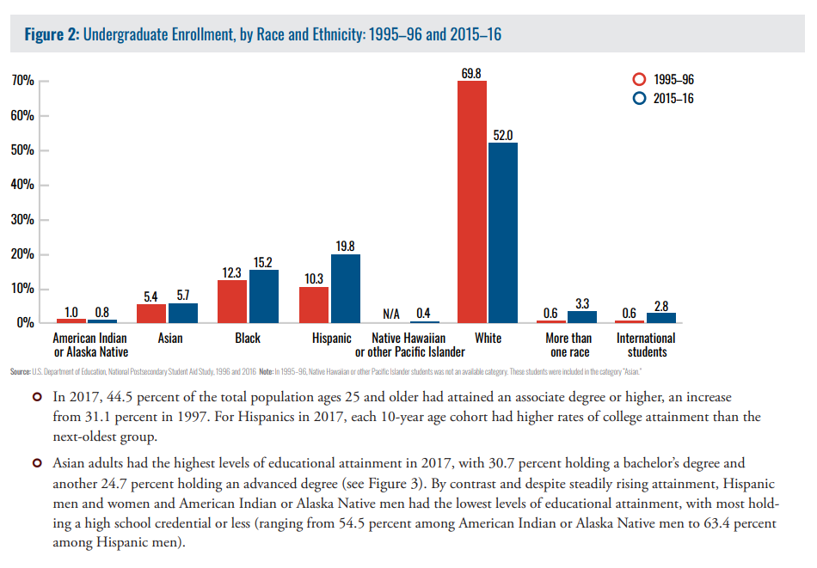

Slide 28
Some Common Challenges Faced by SOC
Racism and intolerance
Islamophobia
Stereotype Threat
Microaggressions (https://www.buzzfeed.com/hnigatu/racial-microagressions-you-hear-on-a-daily-basis)
Being viewed with suspicion
Cyberbullying
Unreasoned expectations
Low academic self-esteem
Discrepancy between the student’s culture/home environment and the university
Feeling lonely or misunderstood
Cultural mistrust of counseling
Being viewed as a representative of their race
Burden of explaining oneself
Burden of having to be grateful for the opportunity
Feelings of intruding on white space
Racial underrepresentation
Economic challenges (Contrary to stereotyped beliefs SOC do not have grants and government agencies tripping all over themselves to cover their costs)
Lack of supportive network
Historical/Cultural trauma and stress
  Post-traumatic slave syndrome Leary, Joy DeGruy. (2005). Post traumatic slave syndrome : America's legacy of enduring injury and healing. Milwaukie, Oregon :Uptone Press,

Slide 29
Equity in Mental Health Framework
The Steve Fund and JED Foundation have partnered to produce the Equity in Mental Health Framework (EMHF). This is a model for colleges and universities for on-campus programs to support the emotional well-being and mental health of students of color. With it are found specific observations, case study examples, and recommendations.
Consider reading the report and having a discussion as a counseling center.

Slide 30
EMHF Recommendations
RECOMMENDATION #1: Implementation Strategies
1: “Identify and promote the mental health and well-being of students of color as a campus-wide priority.”
RECOMMENDATION #2: Needs Assessment
2: “Engage students to provide guidance and feedback on matters of student mental health and emotional well-being.”
RECOMMENDATIONS #3-8: Program Implementation
3: “Actively recruit, train, and retain a diverse and culturally competent faculty and professional staff.”
4: “Create opportunities to engage around national and international issues/events.”
5: “Create dedicated roles to support well-being and success of students of color.”
6: “Support and promote accessible, safe communication with campus administration and an effective
response system.”
7: “Offer a range of supportive programs and services in varied formats.”
8: “Help students learn about programs and services by advertising and promoting through multiple
channels.”

Slide 31
Some EMHF Recommendations Cont.
RECOMMENDATION #9: Program Evaluation
9: “Identify and utilize culturally relevant and promising programs and practices, and collect data on effectiveness.”
RECOMMENDATION #10: Program Dissemination
10: “Participate in resource and information sharing (within and between schools).”

Slide 32
Strengthen Competencies
AMCD Multicultural Counseling Competencies
Competency sections:
Counselor awareness of own cultural values and biases
Counselor awareness of client’s worldview
Culturally appropriate intervention strategies
The 3 competency sections are each divided into the areas of:
Beliefs and attitudes
Knowledge
Skills
With several competency specifics each.
https://www.counseling.org/resources/competencies/multcultural_competencies.pdf
Arredondo, P., Toporek, M. S., Brown, S., Jones, J., Locke, D. C., Sanchez, J. and Stadler, H. (1996) Operationalization of the Multicultural Counseling Competencies. AMCD: Alexandria, VA

Slide 33
To Consider
Failure to consider the ways in which slavery, and various other historical traumas affect aspects of clients’ experiences and presenting problems may lead therapists to conceptualize cases from the default perspective of the dominant discourse, which may lead to ineffective treatment or even harm.
Residual effects of slavery: What clinicians need to know
EJ Wilkins, JB Whiting, MF Watson, JM Russon, AM Moncrief
Contemporary Family Therapy 35 (1), 14-28

Slide 34
Resources
https://raceandpedagogy.ssc.wisc.edu/getting-started/terminology/
https://www.equityinhighered.org/
https://www.chronicle.com/article/Nearly-Half-of-Undergraduates/245692
https://educationpost.org/students-of-color-need-to-see-more-people-of-color-that-shouldnt-be-controversial/
https://www.higheredtoday.org/2018/04/02/college-students-color-confronting-complexities-diversity-culture-mental-health/
https://bbk12e1-cdn.myschoolcdn.com/ftpimages/163/misc/misc_187905.pdf
https://sph.umn.edu/site/docs/hewg/microaggressions.pdf
https://www.buzzfeed.com/hnigatu/racial-microagressions-you-hear-on-a-daily-basis
http://www.isacs.org/uploads/file/Annual%20Conference/Annual%202014/Samuels%20Microaggressions%20in%20everyday%20life.pdf
https://www.columbiaspectator.com/news/2017/11/16/i-dont-feel-like-i-belong-for-students-of-color-unique-challenges-shape-columbia-experience/
https://www.counseling.org/resources/competencies/multcultural_competencies.pdf

Slide 35
Abstract references
Huebner, Angela J. (2012). Advice to the therapists working with military families
National Council on Family Relations March 2012 report. Retrieved from https://www.higheredtoday.org
Primm, Annelle B. (2018). College Students of Color: Confronting the Complexities of Diversity, Culture, and Mental Health. Higher Education Today April 2, 2018 blog. Retrieved from https://www.ncfr.org
The Steve Fund and JED Foundation. (n.d.). Equity in Mental Health Framework: Actionable Recommendations for Colleges and Universities to Support the Emotional Well- Being and Mental Health of Students of Color. Retrieved from https://equityinmentalhealth
Williams, G., Case, R. & Roberts, C. (2018). Understanding the Mental Health Issues of International Students on Campus. Educational Research: Theory and Practice, 29(2), 18-28.

