Slide 1
Highly Sensitive
at College
Daniel Miller, M.S., NCC
Notes:
Hi everyone! I just wanted to thank you all for attending this webinar today, I’m really excited to share some of my knowledge about highly sensitive people and how they can be a great addition to your camp staff or campers, as long as we pay attention to their unique needs!

Slide 2
Hello!
I’m Daniel Miller, M.S., NCC
Ph.D. Student, Counseling and Counselor Education
National Certified Counselor (NCC)
Former College Counseling Intern
Future Post Graduate Resident
Highly Sensitive Person
Notes:
But first, I should probably let you know a little bit about who I am! My name’s Daniel Miller and I’m currently a doctoral student in the department of counseling and human development at the University of Rochester. I have my Master’s degree in Mental Health Counseling from SUNY Oswego, I’m a National Board Certified Counselor. Right now I’m a college mental health counselor at the University of Rochester Counseling Center, and I previously worked doing counseling at the Le Moyne College Counseling Center. I’m also a highly sensitive person myself, and it’s a very important part of my identity. And last but certainly not least, I’m a camp husband! My wife Mandi Miller is the director of Camp Comstock which is a Girl Scout camp in Ithaca! (Last year I got to work in the kitchen!)

Slide 3
What are we talking about?
Understanding Sensitivity
What is sensitivity?
Who are Highly Sensitive People (HSPs)?
What makes HSPs different from others?
Strengths & Challenges of HSPs
What environments do HSPs thrive in?
What environments provide challenge to HSPs?
What are some key strengths of HSPs?
What are some key challenges HSPs face?
HSPs at College
How can I assess whether my client is highly sensitive?
What are some unique needs of HSP’s in the campus environment?
How can I support HSP clients?
Notes:
So, today we’re going to be talking about three main topics. The first is about understanding what sensitivity is. We all tend to get a lot of messages about what sensitivity is and isn’t as we grow up, so this section will explain how researchers define sensitivity, and describe the differing levels of sensitivity we’re all born with, as well as answering the questions on your screen!
Next, we’ll talk about the strengths and challenges of highly sensitive persons, or HSPs, as well as how to assess for high sensitivity. So hopefully this section will give you a greater understanding of some of the environments that do and don’t suit HSPs, as well as some of their strengths and areas that provide them with added challenge compared to others.
And then finally, we’ll talk about specifically the campus environment and HSPs, and how to create a campus and therapeutic environment that is more conducive to the success of highly sensitive students.

Slide 4
Why is understanding sensitivity important?
A profound mediator
“A factor at least as potent in its effect as gender and ethnicity” in a person’s life (Aron, 2010, p. 4)
Invisible Minority
Sensitivity Privilege
Notes:
is a personality trait that, in reaction with environment, is a profound predictor of mental health and developmental outcomes.
"A factor at least as potent in its effect as gender and ethnicity"
Invisible minority- We'll talk about it more later, but HSPs make up just 20% of the population and the highly sensitive trait causes them to experience the world significantly differently from the rest of the population. However, very few people are aware of the sensitive trait, and you can't tell someone is highly sensitive just by looking at them, which causes some unique challenges. This trait also intersects with other sociocultural factors such as gender and ethnicity.
Our world is designed for the lower sensitive majority. Our campuses, classrooms, workplaces, etc. are all designed in ways that don't lend themsevles to the success of HSPs. Helping HSPs navigate their way of being in the world is an important part of doing therapy with HSPs.

Slide 5
What are some other words that come to mind when you hear the word “sensitive?”
An innate temperament trait defined by depth of cognitive processing, and emotional responsiveness to social/environmental stimuli
Notes:
Sensitivity has been given many meanings and connotations throughout history. What comes to mind when you hear the word “sensitive”?
Maybe: emotional, touchy, reactive, shy, artistic, moody, soft, gentle
However, in personality and social psychology, sensitivity is defined as “An innate temperament trait defined by depth of cognitive processing, and increased emotional responsiveness to social and environmental stimuli.”

Slide 6
Understanding Sensitivity
Dandelions, Tulips, & Orchids
Notes:
So we’re gonna start off with talking a little bit about what sensitivity is, and then I’m going to describe to you what we call the sensitivity garden, which consists of dandelions, tulips, and orchids...that’ll make a lot more sense later!

Slide 7
The Sensitivity Garden
Dandelions (Lower Sensitive)
Tulips (Moderately Sensitive)
Orchids (Highly Sensitive)
Notes:
Sensitivity is a biological temperament trait that we’re all born with. Being a temperament trait, sensitivity is part of our personalities, so it remains relatively consistent over time. Therefore, it’s important to understand that someone’s level of sensitivity is largely out of their control. A person can’t just be “less sensitive,” their nervous system is wired to respond to the environment at a certain level.
These differing levels of sensitivity have been found across animal species, from fish, to capuchin monkeys, to birds, to dogs, and humans. Our differing levels of sensitivity allow our species to survive under many different social and environmental circumstances, because each sensitivity group has a different set of strengths under different circumstances.
Recent research (2018) that the human population consists of three distinct sensitivity groups, dandelions, tulips, and orchids.
Dandelions are the lower sensitive group. Tulips are the moderately sensitive group, and orchids are the highly sensitive group (the focus of our talk today).

Slide 8
Dandelions
Lower Sensitive
Approx. 20-30% of the population
Able to do well in most environments
Less responsive to positive environments
More likely to be extraverted
Notes:
Dandelions are rank the lowest on sensitivity, and consist of somewhere between 20-30% of the population (still need more research).
Dandelion people are named this way because like dandelions, they can survive just about anywhere, just like how dandelions can grow through cracks in concrete or just about anywhere else you put them. They’re resilient even in adverse environments.
However, a downside of being lower sensitive is that while negative environments don’t have a huge impact on dandelions’ mental health or personal development, neither do positive ones. They sort of are where they’re at.
Finally, dandelions tend to have more extroverts in the group than the other two groups. This doesn’t mean that all dandelions are extroverts, just that they’re more likely to be.

Slide 9
Tulips
Moderately Sensitive
Approx. 40% of population
Responsive to negative and positive environments, but not as much as orchids
Equally as likely to be introverted or extraverted
Notes:
Tulips are the moderately sensitive group and they take up the majority of the population at 40%, so, most people fall into this category. Tulips are the newest discovered sensitivity group so their flower might not make as much sense as the others.
You probably won’t notice if you or someone else is a tulip because they’re sort of just at an average sensitivity level. Since they’re the majority of the population, most systems in our society are designed around their levels of sensitivity. They’re responsive to both negative and positive environments or experiences, but just not as much as the orchids.
They’re equally likely to be introverted or extraverted.

Slide 10
Orchids
Highly Sensitive
Approx. 20-30% of the population
More quick to wilt in negative environments
Able to flourish in positive environments
More likely to be introverted
NOT a mental health disorder
Notes:
Finally, we have the orchids, which are the highly sensitive group and the focus of this presentation. Orchids make up somewhere between 20-30% of the population. Orchids are the most strongly impacted by negative AND positive environments. So, just like an orchid, if the circumstances aren’t right, they won’t bloom or flourish. But when orchid people are supported and nurtured in the right ways, they can be some of the most remarkable flower people around!
Orchids are most likely to be introverted of any of the groups, so a lot of the traits of HSPs are shared with introverts. HOWEVER, actually 30% of HSPs are extraverts, which can present unique challenges for individuals who fall in that group because they can wear themselves out!
An important note is that being an HSP is NOT a mental health disorder. For a long time, researchers associated being highly sensitive with having a neurotic personality, being socially anxious, or even being on the autism spectrum. However, being highly sensitive is really just a trait that 20-30% of the population is born with, and now is considered more of a “neutral” trait, that provides advantages in some circumsances, and challenges in others.

Slide 11
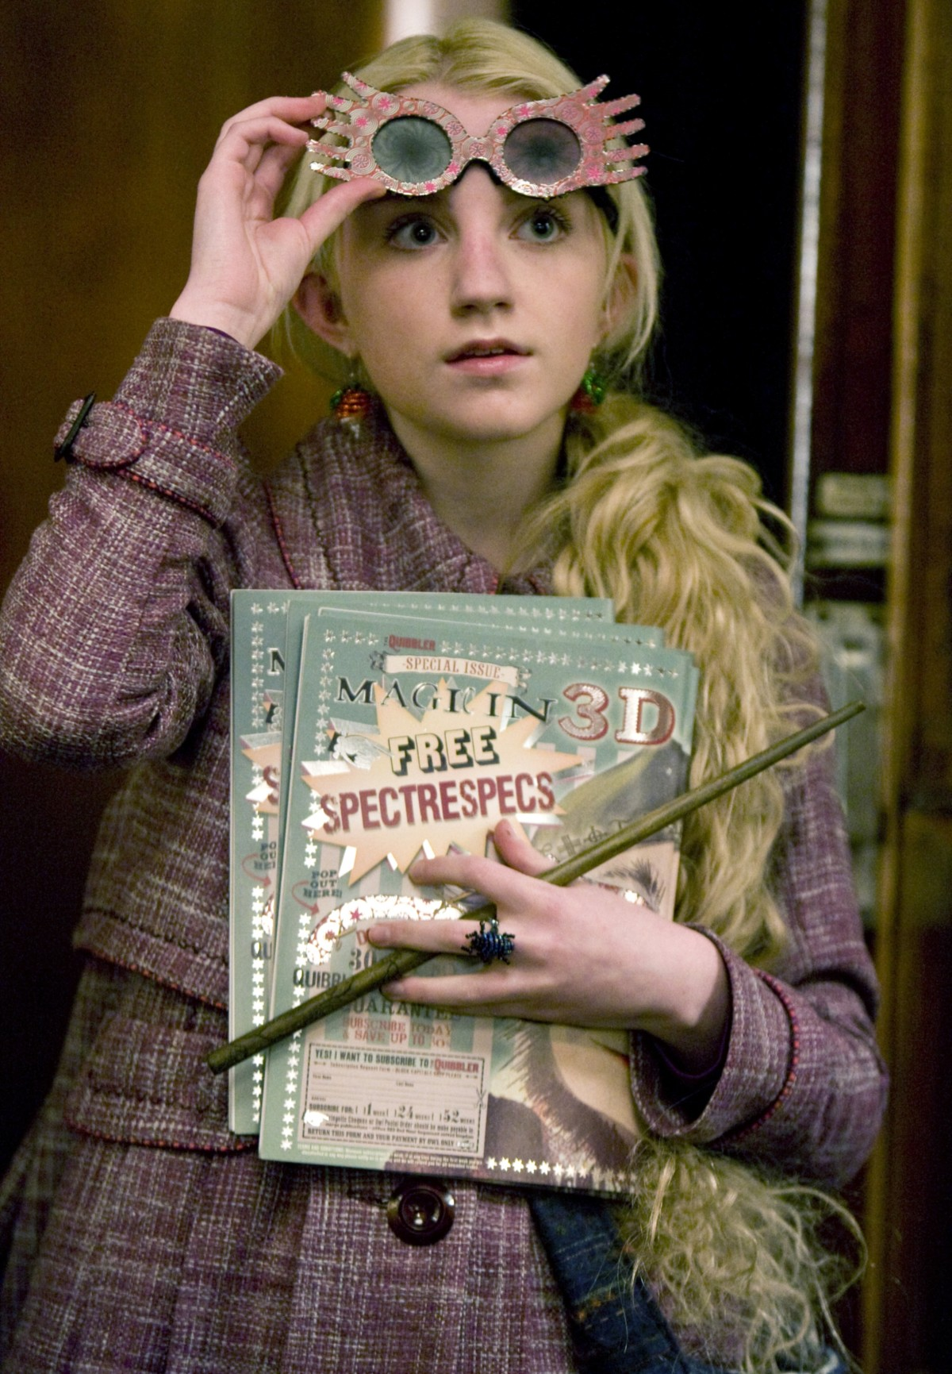
Some familiar HSP Faces
Notes:
But first, I wanted to start by acclimating you a bit to what HSPs can be like. Sometimes we develop our own images of what sensitivity might be, and in fact studies show that our society biases us to devalue or oppress qualities of sensitivity in ourselves and others.
So, here might be a few characters you might now that have earned my stamp as likely HSPs!
Hiccup from How to Train You Dragon. Hiccup is quieter than the other vikings, he’s sensitive to dragons, doesn’t want to hurt them, observes them, and trains them.
Luna from Harry Potter. She’s very unique, also sort of tries to observe people. Makes connections with others. Quickly reads others’ emototions. Is aware of things in the environment that other people often don’t see.
Newt Scamander from Fantastic Beasts movies. A lot of the same traits as the previous two. Prefers the company of his magical creatures over people, seems to be overwhelmed by others. Empathetic and caring.
And then probably the most familiar is Queen Elsa from Frozen. She actually shows a super common struggle for many HSPs. “Conceal don’t feel.” She’s quiet and reserved but has all this emotion that she has difficulty controlling. She’s afraid of hurting other people and isolates herself because of it.

Slide 12
Assessment of
High Sensitivity
Notes:
So, this next section is going to talk about how to assess for high sensitivity in clients, and how to distinguish high sensitivity from some DSM diagnoses.

Slide 13
Depth of Processing
Over-arousability
Emotional Intensity/Empathy
Sensory Sensitivity
Notes:
So okay. Sensitivity researchers have come up with this acronym ‘DOES’ to encompass the main traits of HSPs that set them apart from others. It’s not the best acronym, but it’s what we’ve got! DOES stands for: Depth of Processing, Over-arousability, Emotional Intensity/Empath, and Sensory Sensitivity. And we’re gonna go over what each of those traits are, and what they might look like in your campers and staff.
I should also mention the HSP Scale, which is a 27 item questionnaire with sound validity and reliability to determine whether someone is an HSP.

Slide 14
Depth of Processing
What it is:
More complex cognitive processing of social and environmental stimuli. Reflecting on experiences to a greater extent than others.
What it looks like:
Pausing before acting
Observing on the sidelines
Needing time and space to make decisions
Conscientiousness
Deep thinker
Notes:
What it is:
More complex cognitive processing of social and environmental stimuli. Reflecting on experiences to a greater extent than others.
What it looks like:
Pausing before acting
Observing on the sidelines
Needing time and space to make decisions
Conscientiousness
Deep thinker

Slide 15
Over-arousability
What it is:
More quickly overstimulated, reaching state of flight/flight/freeze than quicker than others.
What it looks like:
Anxiety
Social Isolation
Timid behavior or “nervousness”
Trouble focusing/thinking, headaches/stomach aches
If overarousal continues: panic
Notes:
What it is:
More quickly overstimulated, reaching state of flight/flight/freeze than quicker than others.
What it looks like:
Anxiety
Timid behavior or “nervousness”
Trouble focusing/thinking, headaches/stomach aches
If overarousal continues: panic

Slide 16
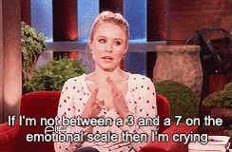
Emotional Intensity/Empathy
What it is:
Stronger emotional reaction to both positive and negative experiences. Increased ability to understand the emotions and experiences of others.
What it looks like:
Preferring deeper/intimate relationships
Strong sense of justice/concern for others
Sentimental
Notes:
What it is:
Stronger emotional reaction to both positive and negative experiences. Increased ability to understand the emotions and experiences of others.
What it looks like:
Sentimentality
Deeper connections with others
Greater concern for everyone else’s wellbeing

Slide 17
Sensory Sensitivity
What it is:
Greater awareness of environmental & social stimuli. Greater awareness of subtleties.
What it looks like:
Increased sensitivity to light/sound/smell/diet
Increased awareness of the emotional/social cues of others
Notes:
What it is:
Greater awareness of environmental & social stimuli. Greater awareness of subtleties.
What it looks like:
Increased sensitivity to light/sound/smell/diet
Increased sensitivity to the emotional/social cues of others
So hopefully that gives you a little bit more of an understanding of the traits that define HSPs. Often times these traits go unnoticed because HSPs try to keep a lot in, or stay to the side (think Elsa) and then get misidentified as someone being depressed or shy, or anxious, when really they’re just taking in a lot more information than you, and need time to sort through it all!

Slide 18
Distinguishing from DSM Diagnoses
Autism Spectrum Disorder
PTSD
Depression/Anxiety
Somatoform Disorders
Notes:
ASD: Some have suggested that in some ways HSPs resemble possible a mildest form of autism. However, there are some pretty important distinctions between ASD and HSP. HSPs are particularly adept at reading social cues and understanding the emotiosn of others. And while ASD and HSP share a depth of processing, HSPs usually don’t experience fixed interests on a particular subject, but rather just experience everything more deeply.
PTSD: Obviously the biggest distinction here would be that a traumatic event would have needed to have occured in order for a PTSD diagnosis. However, HSPs may be at higher risk for HSPs, since they process experiences more deeply, events that may not be traumatic to some may be experienced as traumatic to HSPs.
Depression/Anxiety: HSPs experience higher rates of depression and anxiety compared to the rest of the population, particularly if they experienced difficult childhoods. Often times HSP clients may enter the room believing they have chronic depression, social anxiety, or generalized anxiety when in actuality they are just highly sensitive. It’s possible that both are happening. The key to determining if someone is just depressed/anxious or if they are HSPs or both, is to take note that ALL of the DOES criteria appear to be there.
Somatoform: Talk about depersonalization client.

Slide 19
Highly Sensitive
at College
Notes:
Alright, so that brings us to our final section which is probably what you all are most excited for, which is how to work with highly sensitive students. Like I said, the college environment can be an intimidating one for HSPs, but also can be a life-changing developmental experience for them, so hopefully these tips help you get a little more in tune with those more sensitive folks at your university so you can set them up for success!

Slide 20
Common Struggles of HSPs at
College
Adjustment to new setting
Social Adjustment
Self-esteem
Sensitivity to Criticism
Notes:
Common struggles of HSPs at college include:
Adjustment to a new setting
Social Adjustment
Self-esteem
Sensitivity to criticism

Slide 21
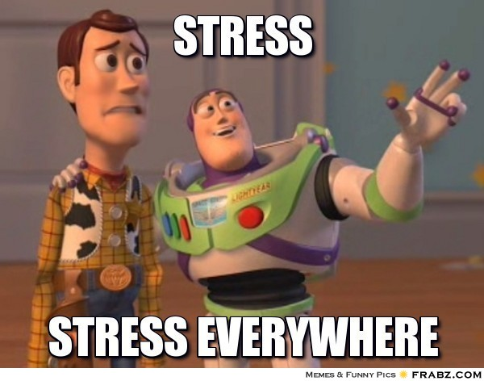
Adjustment to College
Notes:
Moving into college is a daunting experience for many college students. However, for a highly sensitive student, the adjustment can be especially overwhelming. Because HSPs process things at a deeper level than the majority of the population, they need time to process all of the changes they are experiencing, and often don’t do well in college orientation experiences or program expectations that require long days of socializing and activities. Clients who same to be having a particularly difficult time making adjustments to their new setting may be highly sensnitive, and may feel flooded with new experiences and stimlui that they aren’t getting enough time to process. College counselors can help by normalizing this experience, validating that moving into college is a particularly stressful life event, and discussing strategies for making time to process changes and manage any anxiety that might be associated with these changes.

Slide 22
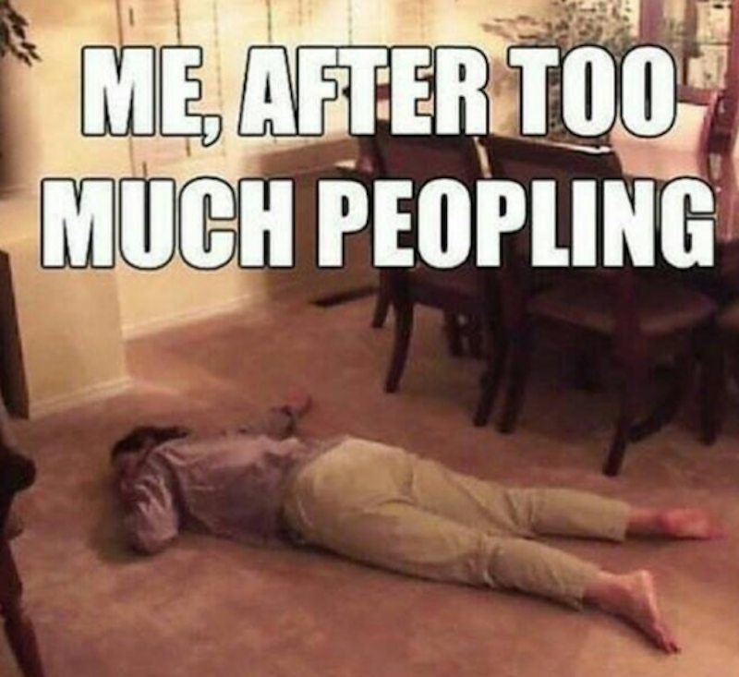
Social Adjustment
Notes:
A large part of making new friends on many college campuses is attending large group gatherings, such as parties, mixers, floor activities, etc. Considering 70% of HSPs are introverts, and those who are extroverts still need extra time to recharge after social interaction, this can lead to some difficulty for HSP students. In particular, students may feel that they can’t connect with others in these large settings, and find themselves overwhelmed by too much noise or too much shallow conversation. This can lead to students internalizing a distorted message that they are somehow socially incompetent or suffer from social anxiety, when in actuality, it’s just that large gatherings are not the type of socializing where they flourish. These feelings of incompetence can lead to isolation, since HSP students begin to think that any and all social interaction is just too overwhelming for them.
How to help:
Help normalize the experience of not enjoying large group gatherings. Explain the differences between introversion, extraversion, and different levels of sensitivity, and how these traits give people different sets of skills for different types of socializing.
Help students develop a plan to form relationships in smaller settings (maybe with other students in their suite/on their floor, or joining a small club of students with similar interests). Also, help students get in touch with their bodies to notice their “socialization threshold,” maybe they can handle an hour out at a party, but after that they need to go home.
Normalize FOMO. And help develop a strategy where the student can go to some important events with friends, but also use strategeis or make time to take breaks to recharge or decompress.
Help HSP students to be okay with their way of being in the world. Normalize that they may have to operate a bit differently from the rest of the population, but that in doing so they are making themselves unique and utilizing their particular strengths.

Slide 23
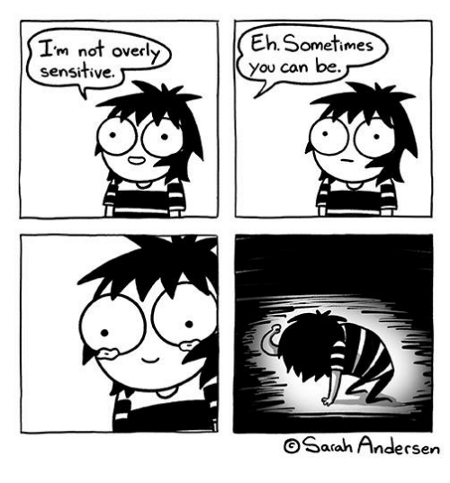
Self-esteem/Self-stigma
Notes:
Many HSPs can be extremely frustrated with the sensitive trait, wishing they could just operate like the rest of their friends or family members. In fact, many HSPs grow up hearing from family, loved ones, and mentors that they are “too sensitive,” need to “toughen up,” or something of the like. This can really hamper self-esteem, and make HSPs feel as if there is something fundamentally wrong with them. A kind counselor who introduces the HSP trait and helps the client understand taht this is a NORMAL trait that is present in 20% of the population can really help to reduce that self-stigma. Counselors can also help by striving to help clients recognize the strengths that come from being highly sensitive, including conscientiousness, noticing subtleties and details that others miss, a greater sense of justice, empathy, or strong moral compass; greater creativity, etc.

Slide 24
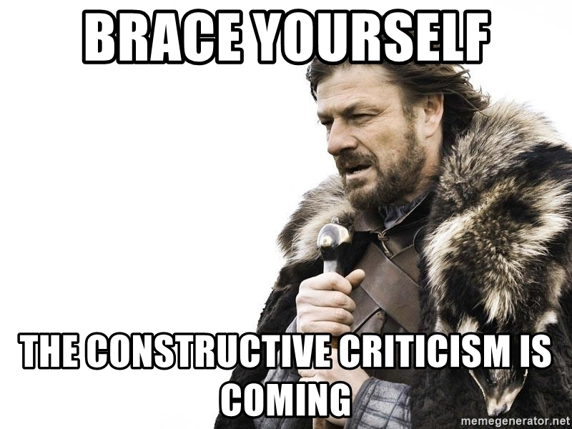
Sensitivity to Criticism
Notes:
Another common difficulty of HSPs is that they are particularly sensitive to criticism. *share story about being yelled at in 1st grade*
This can on one hand be a great asset, because HSPs really internalize constructive criticism and can make necessary changes to improve more readily than others. However, this becomes a hindrance when HSPs internalize criticism as a fundamental flaw and feel shame, or when criticism is offered in a hostile manner. This can cause HSPs to shut down.
First, help HSPs distinguish what the criticism was actually about, if it’s valid, and what other nuances they may have picked up on.

Slide 25
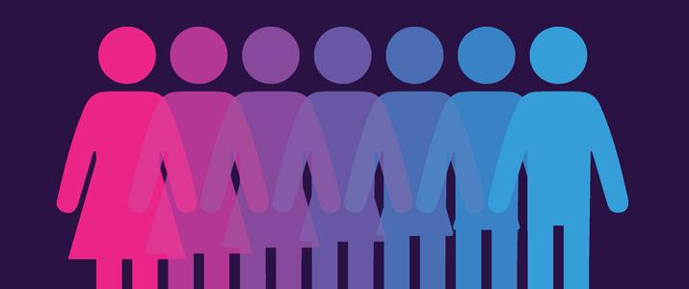
Struggles related to Gender Socialization
Notes:
High SPS is present in equal frequency in both men and women. Highly sensitive men and women face unique challenges related to gender socialization, and overall, highly sensitive men seem to experience greater difficulties related to their sensitivity compared to highly sensitive women.
In Western society, we have deemed many traits associated with sensitivity as feminine traits. When HSMs display some traits of sensitivity, including increased emotional experiences, greater empathy, preference to pause before doing, etc. they often receive messages that these traits are not acceptable male behaivor. Therefore, many HSMs feel ostracized and defective as men. We can help HSM clients by helping them to identify the strength in their sensitive trait, as well as to help them identify sensitive male figures that they can relate to.
HSW face a different set of challenges. Although many traits of high SPS are associated with femininity in our society, sometimes t hat exacerbates the burden on HSW to “do it all.” HSW are more quickly overwhelmed than others, and when we pressure or require women to be the best students, workers, mothers, partners, they can be, it can cause HSW to feel as if they’re not measuring up to expectations. Additionally, at times HSW’s sensitivity can be taken advantage of, because they become the expect shoulder to cry on, comforter, etc.

Slide 26
Flipping the Script
Embracing an HSP Lifestyle
Notes:
So this final section is about some strategies I've found to be helpful in working with HSP students, as well as flipping the script to help HSPs embrace their sensitivity. Keep in mind I've just started working with HSPs! So more to come on this.

Slide 27
Decreasing Overarousal
Punctuate your Day!
It’s important to punctuate your day, and take small breaks to check in with yourself. Otherwise, you’re just going and going on and on, and you just keep going without stopping to take a breath, and pause to see how you’re feeling. And then you get super stressed out because you haven’t taken a moment all day, and one activity just spills into the next, and your mind is always on the next thing you have to do. So you’re not present and that’s really hard and stressful, and so you should punctuate your day with small moments to breathe, otherwise your day is as exhausting as this run-on sentence.
Punctuate your Day!
It’s important to punctuate your day and take small breaks to check in with yourself otherwise you’re just going and going on and on and you just keep going without stopping to take a breath and pause to see how you’re feeling and then you get super stressed out because you haven’t taken a moment all day and one activity just spills into the next and your mind is always on the next thing you have to do so you’re not present and that’s really hard and stressful and so you should punctuate your day with small moments to breathe otherwise your day is as exhausting as this run-on sentence.
Notes:
Punctuate your Day!
It’s important to punctuate your day, and take small breaks to check in with yourself. Otherwise, you’re just going and going on and on, and you just keep going without stopping to take a breath, and pause to see how you’re feeling. And then you get super stressed out because you haven’t taken a moment all day, and one activity just spills into the next, and your mind is always on the next thing you have to do. So you’re not present and that’s really hard and stressful, and so you should punctuate your day with small moments to breathe, otherwise your day is as exhausting as this run-on sentence.
(click)
And so you can see how punctuating your sentence (or day) with small pauses, breaks, and check ins makes things much more manageable!

Slide 28
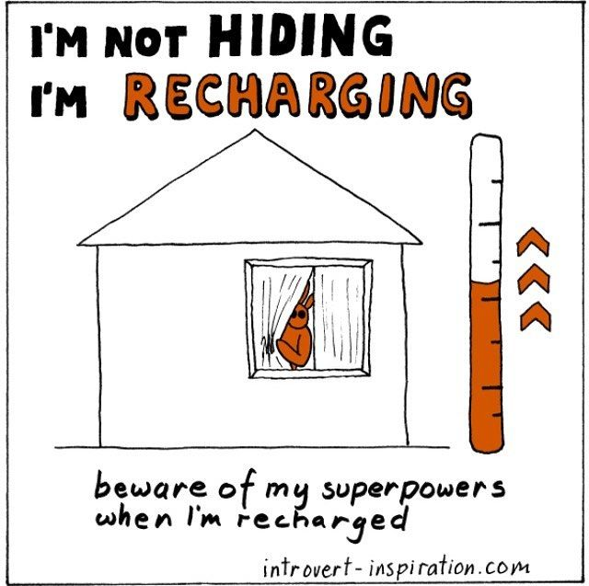
Recognizing Social Strengths
Notes:
Many HSPs feel as if they are socially inept, or can’t make friends because they find it difficult to engage with people as is “normal” in college. However, HSPs are actually great at socializing. They are great at having more intimate ocnversations, talking about important topics with people, etc. And they can still party and go to large events, they just hneed to have a recharge plan in place in order to do so.

Slide 29
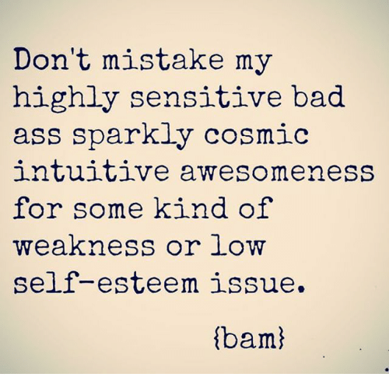
Recognizing the Strength of Sensitivity
Notes:
Don’t mistake my highly sensitive bad ass sparkly cosmic intuitive awesomeness for some kind of wekness of low self-esteem issue. (bam)

Slide 30
Why Empowering HSPs is Important
Notes:
In the world we live in today, the traits of HSPs are in great demand. We need our highly sensitive students to embrace their sensitive skills (rather than hide them). HSPs are excellent listeners, conscientious, astute decision makers, empathic, morally driven, creative. We need sensitive leaders who ensure that everyone has a seat at the table and all voices are heard, and with their great ability to read and egage with others’ emotions, HSPs have a lot to offer in making the world a more compassionate place, but if they walk around thinking that these traits are flaws or defects, than they will spend their lives trying to hid them rather than embrace them. They may walk around thinking they are just especially anxious or melancholic, or socially awkward or shy, without realizing that their trait can be so much more. A positive therapeutic experience can help HSPs to dig deep and embrace who they are and bring all of their sensitive strengths to the table.

Slide 31
Many HSPs are unaware that they even possess the highly sensitive trait, but grow up feeling fundamentally “different” from others. A positive therapeutic relationship where sensitivity is validated can change the way HSPs view themselves, and inspire confidence in the strengths of their sensitivity.
Notes:
Many HSPs are unaware that they even possess the highly sensitive trait, but grow up feeling fundamentally “different” from others (for some of you, hearing about some of the traits on here may even have sparked some of your own thoughts about if you’re maybe highly sensitive). A positive summer camp experience can change the way HSPs view themselves, and inspire confidence in the strengths of their sensitivity.
I think that what you guys do is amazing, and I hope that this presentation helps you make your camp progams even more amazing, just by having an awareness of the highly sensitive population :).

Slide 32
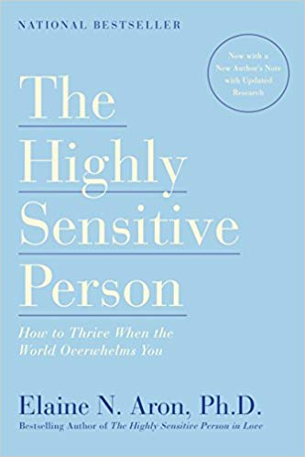
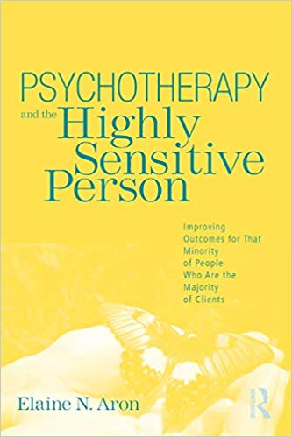
Resources
hsperson.com
Self-test
HSP Scale
Current Research
Notes:
Many HSPs are unaware that they even possess the highly sensitive trait, but grow up feeling fundamentally “different” from others. A positive summer camp experience can change the way HSPs view themselves, and inspire confidence in their strength in their sensitivity.

Slide 33
Contact Me
kindofdifferentblog.com
facebook.com/danielmillerncc
Email: daniel.miller@rochester.edu
Notes:
Many HSPs are unaware that they even possess the highly sensitive trait, but grow up feeling fundamentally “different” from others. A positive summer camp experience can change the way HSPs view themselves, and inspire confidence in their strength in their sensitivity.

