Slide 1
The Psychic Beach:
An Overview of Sandplay Therapy

Slide 2
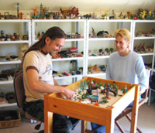
What is sandplay?
“The hands know how to solve a riddle that the intellect wrestles with in vain.”
-C.G. Jung

Slide 3
Sandplay is…
A means of self-discovery, healing and integration
A transformation or redirection of blocked energy
A means by which children and adults, unable to articulate their feelings or experiences, can find expression and integration
Safe entry into the deeper archetypal, mythic and transpersonal realms of the psyche
An activation of our natural, self-healing capacity
Opportunity for creative, non-rational experience, as a balance to society’s overemphasis on the ego’s intellect
-From www.emotional-transformation.com.au

Slide 4
Another description
The use of sand and miniatures gives us a symbolic way of expressing our feelings and viewing our lives. Sandplay provides a fun, non-threatening approach to the unconscious, and a safe space in which to explore feelings and life situations that may feel overwhelming. The client may not have a particular focus in mind, however, playing with the sand, making a landscape, and adding symbols from the shelves, enables the psyche to find its own bearing, free of the ego's influence. Using the sandtray, we are able to play out our fantasies, and to externalize the inner world.
"Sandplay heals wounds that have blocked normal development. It enables the constellation and positive activation of the Self and the emergence of a stable ego capable of relating equally to the outer material and the inner spiritual worlds - to life in the here and now, and to the transpersonal dimension. At its best, sandplay therapy is a prime facilitator of the individuation process. At its least, it is an invaluable adjunctive modality." - Estelle Weinrib 'Images of the Self-The Sandplay Therapy Process'

Slide 5
Sandplay History
Margaret Lowenfeld (1920s)
Dora Kalff, Switzerland (1904?-1990)
Gisela DeDomenico (1980’s , USA Sandplay-Worldplay

Slide 6
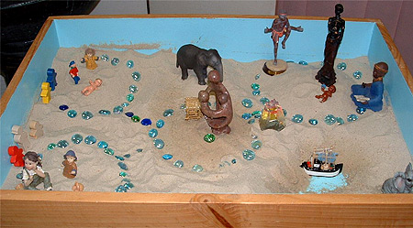
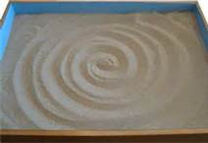

Slide 7
Office Design
Position and orientation of the therapist
Wet and/or dry sand
Collection and display of miniatures

Slide 8
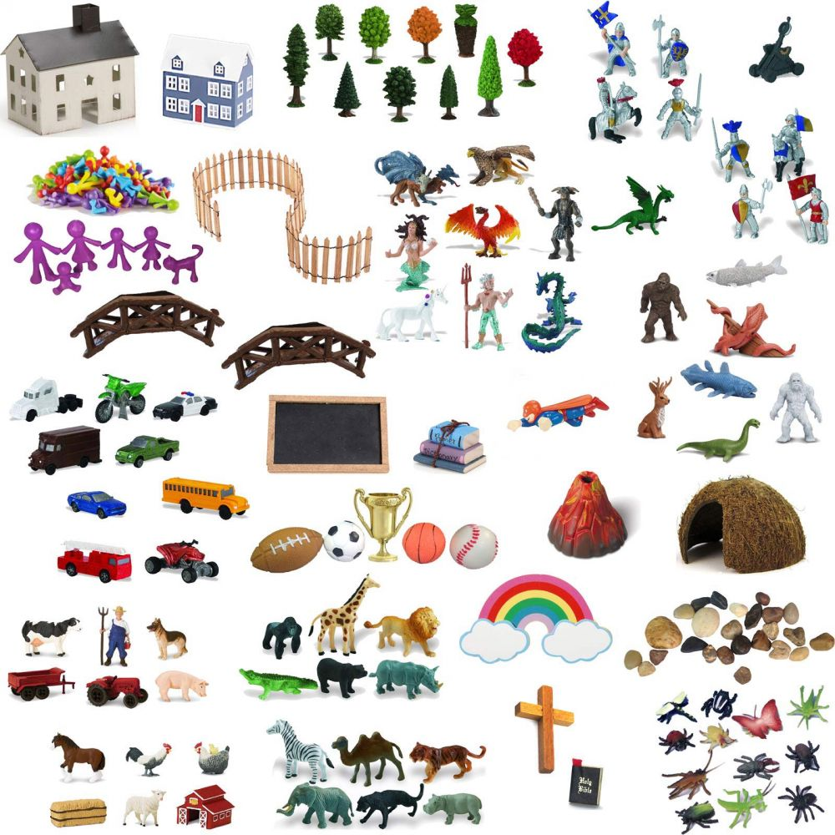

Slide 9
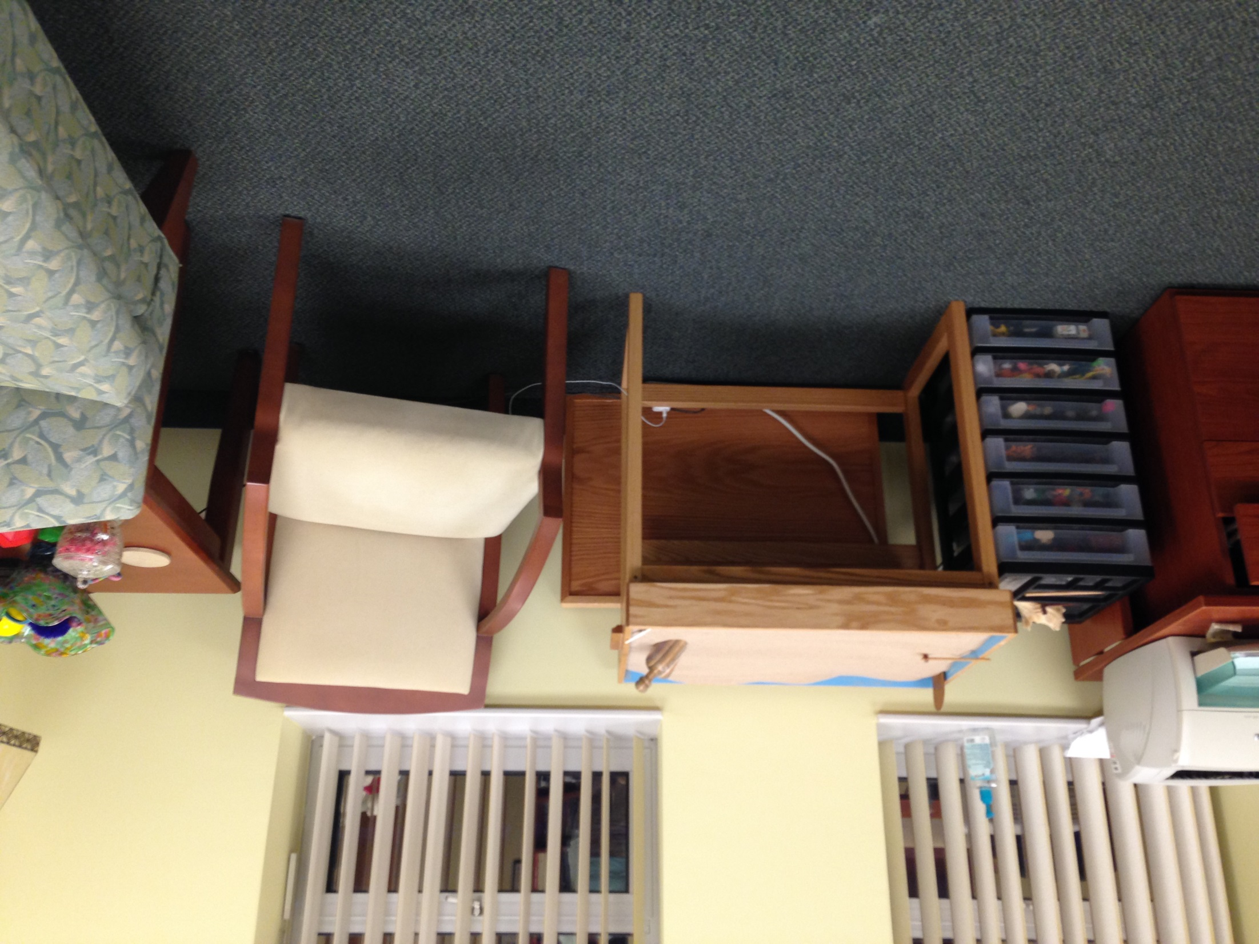

Slide 10
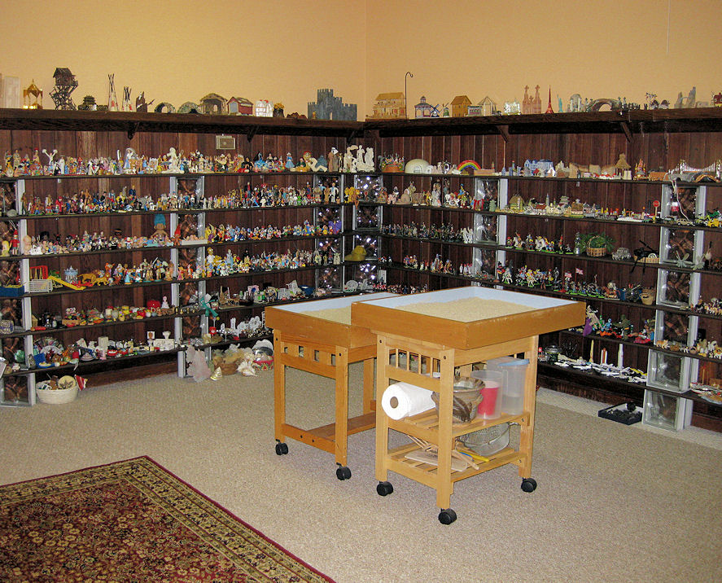
Basic Structure

Slide 11
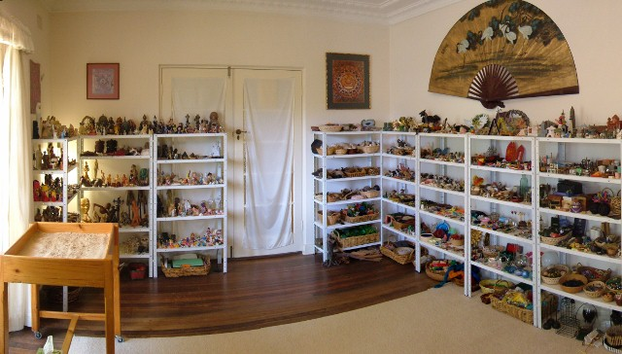

Slide 12
Other Considerations
When to use sandplay or the sandtray in therapy
Contraindications- dissociation, psychotic disorders
Moving or static pictures
Choosing a professional sandtray
How to present to the client

Slide 13
Yes, they come in round too!
(Useful for groups)

Slide 14
Case Study

Slide 15
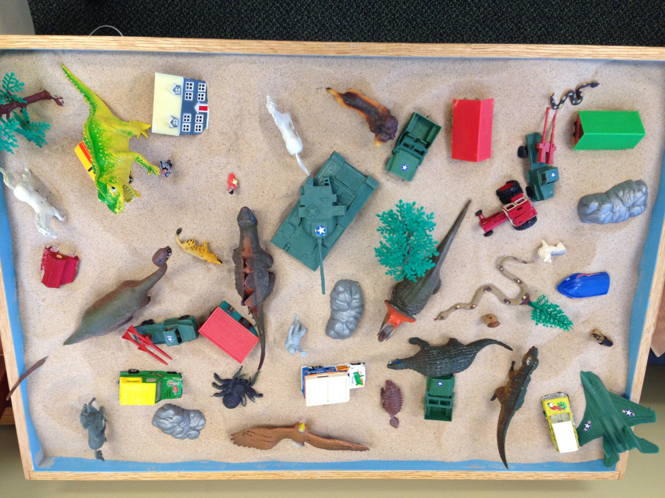

Slide 16
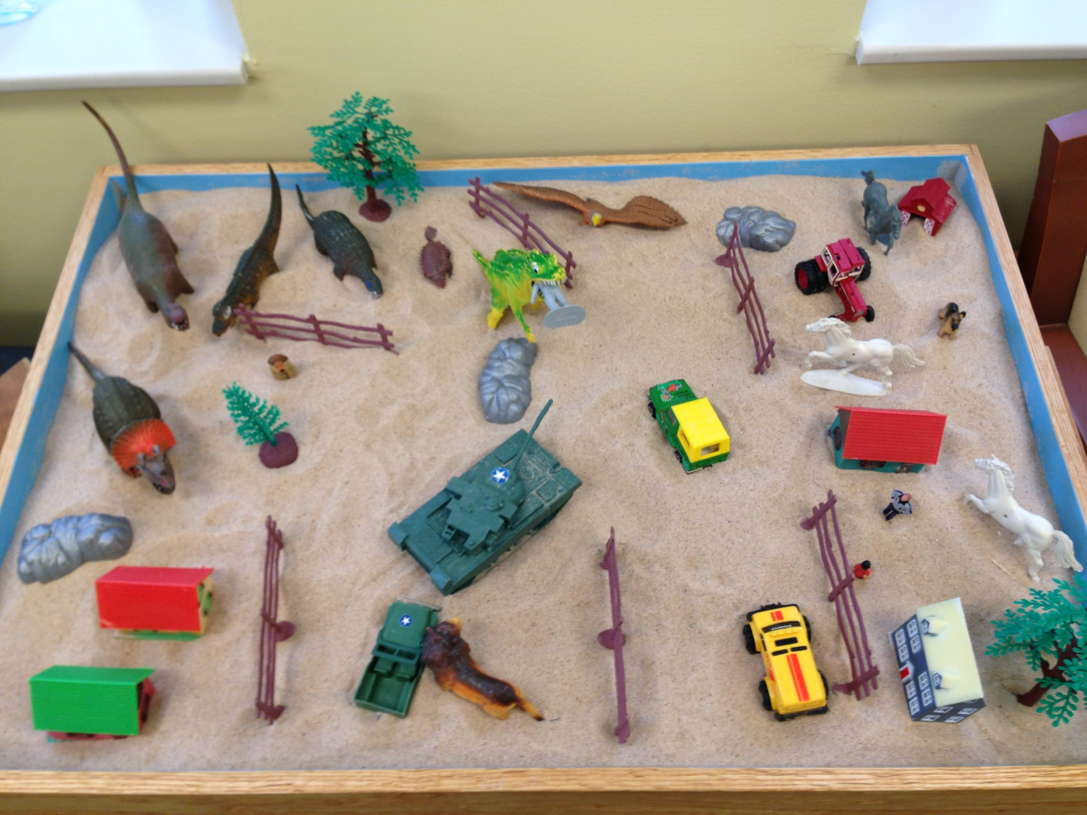

Slide 17
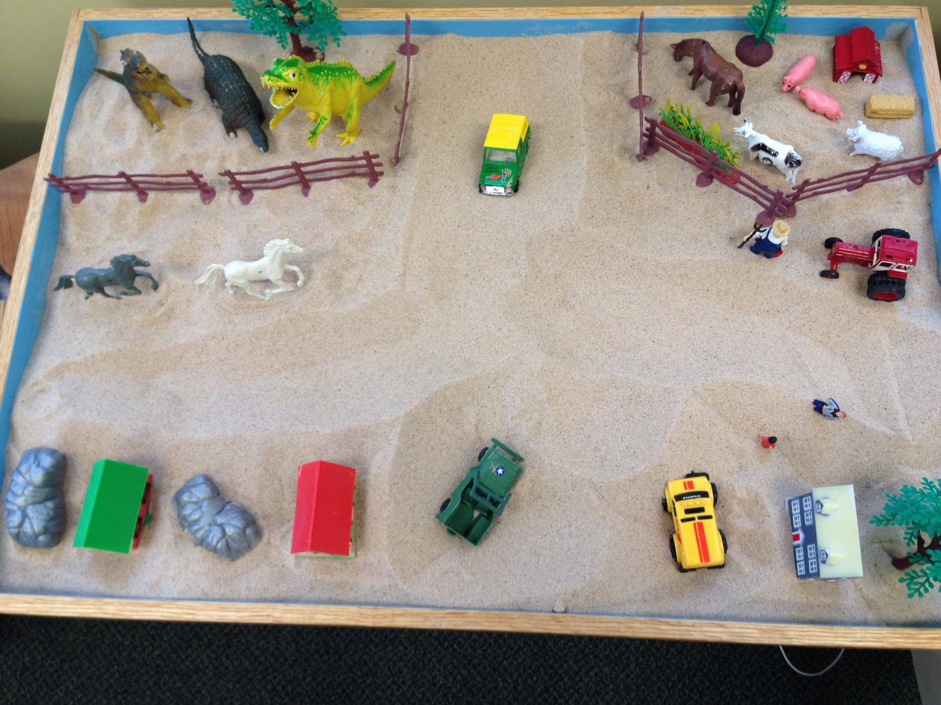

Slide 18
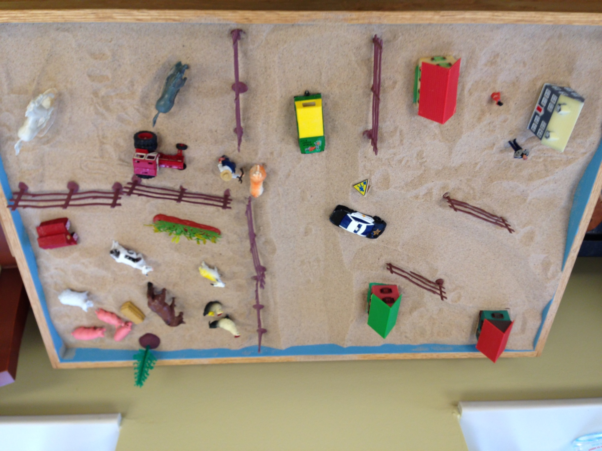

Slide 19
How would you interpret this one?

Slide 20
To Learn More…
Sandplay Therapists of America www.sandplay.org
International Society for Sandplay Therapy (Kalff) www.isst-society.com
Vision Quest into Symbolic Reality (DeDomenico) vision-quest.us
Association for Play Therapy www.a4pt.org
Books and Journal Articles
Miniature resource: www.selfhelpwarehouse.com

Slide 21
Books
Sandtray Therapy: A Practical Manual, By: Linda Homeyer & Daniel Sweeney
Sand Tray World Play: A Comprehensive Guide to the Use of the Sand Tray in Psychotherapeutic and Transformational Settings, By: Gisela Schubach De Domenico
Sandplay Studies: Origins, Theory and Practice
Sandplay Therapy: A Step-by-step Manual for Psychotherapists of Diverse Orientations, By: Barbara Labovitz & E. Anna Goodwin
The Handbook of Sandplay Therapy, By: Barbara Turner
Sandplay Therapy with Children and Families, By: Lois Carey

