Slide 1
Breaking Down Barriers between Counseling Centers and Athletic Departments: My Efforts to Become an Ally and Improve Team Grit.
Brittany Higgins, M. Ed.
Utica College

Slide 2
Purpose and Objectives:
Discuss the difficulties of inter-departmental relationships (specifically) between counseling and athletics.
Explore the differences between working with student-athletes and general college population (what makes that culture different).
Discuss my attempt at increasing team Grit through a 10-week workshop that I designed and implemented across 6 different athletic teams.

Slide 3
Why is this important?
At UC we have approximately 700 student-athletes. That makes up nearly 1/3 of our on campus students.
Recent legislation passed in January 2019 for Power 5 Conferences
Stats?
Is it actually comparable to non student-athletes?
Student-Athletes are different today- Coaches are asking for help

Slide 4
Phase 1: Understanding the Student-Athlete
What is the culture of today’s college student/student-athlete?
What is their mindset?

Slide 5
Now vs. then
When
Where
Training
Equipment
Uniforms
Choosing sides
Rules
Refreshments
Rewards for playing

Slide 6
Unintended Consequences
Their world is full of | Consequently, they can assume
Speed | Slow is bad
Convenience | Hard is bad
Entertainment | Boring is bad
Nurture | Risk is bad
Entitlement | Labor is bad

Slide 7
Fixed vs. Growth Mindset
Fixed Mindset | Growth Mindset
Skills and talents are set | Skills and talents are grown and can be developed
You don’t have control over your abilities | You are in control of your abilities
You can’t learn and grow | You can learn and grow

Slide 10
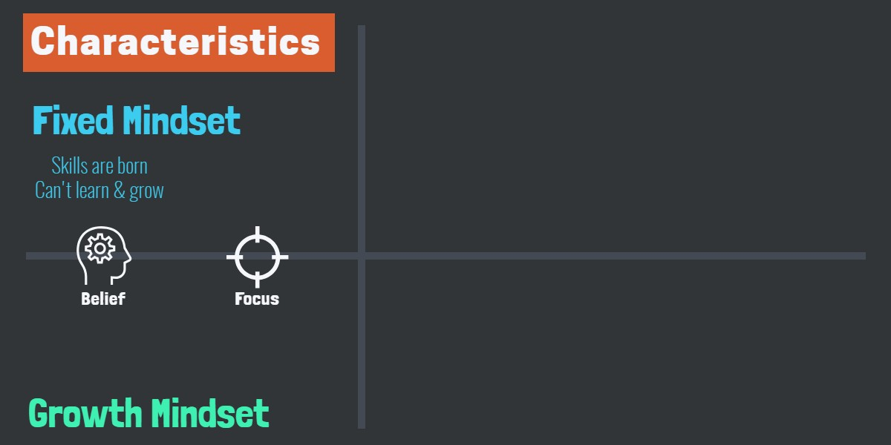

Slide 17
Phase 2: Understanding Athletic Department & Coaches
How do they like to be communicated with?
What are their expectations?
History with Counseling Center on campus?

Slide 18
Phase 3: Reach out!
Coaches don’t typically have time to respond to emails.
Unless you have their cell number, coaches are difficult to contact via phone.
They are very protective of their athletes, teams, assistant-coaches and may be suspicious of you coming in.
Appreciate clear and direct communication; however, it’s important that you acknowledge their expertise, the difficulties of their job etc. in order to get buy in.
Notes:
I’m going to make some generalizations with athletic departments, coaches, and even student-athletes. If you want to meet with someone across your campus in a different department, how would you reach out?

Slide 19
Phase 3 continued:
Hello Coach ______, I hope the summer has been serving you well. I am reaching out to you because I have set a goal for myself to attend at least 1 practice of every sport this year. I would like to just very briefly introduce myself to the team with the goal that they gain a familiar face in the Counseling Center so it's easier to access in the future if need be. I would not want to take more than 2 minutes of your team's time. I would also love to stay and observe what your team does in a typical practice if you would allow for that, but I understand not every coach may be comfortable with that. I am flexible and happy to attend a typical practice, lifting session or whatever is convenient for you. Please let me know if your schedule allows for this. Best regards, Brittany

Slide 20
More of Phase 3…
When email fails, get familiar with your athletic center and start knocking!
Be a presence in your athletic facilities

Slide 21
Phase 4:
Buy swag!
Meet with the teams
Introduce self, ask if they know how to access services, where you are located (always provide prizes if they know the answers)
Follow up with thank you emails to coaches and request team roster
Email team your contact information

Slide 22
Tips for reaching every team
Make nice with your AD
Every student-athlete has to attend a mandatory NCAA meeting prior to the start of their season. You can potentially meet several teams at once here if you can get to practices.

Slide 23
Phase 5: Workshop
Based on Angela Duckworth’s work on Grit
10 weeks, 15 minutes/session each week
Pre and Post test to measure Grit
Also measured overall team GPA and team conference results
Initially offered to 4 teams in Fall
Every team was also offered a continuation of services after workshop ended

Slide 24
Week 1: Introduction, consents, questions and pre-test
Student Athlete Survey
Section 1
Directions: Here are a number of statements that may or may not apply to you. When responding, think of how you compare to most people --not just the people you know well, but most people in the world. There are no right or wrong answers, so just answer honestly! Please mark one response per question.
Questions include:
(1) New ideas and projects sometimes distract me from previous ones (2) Setbacks don’t discourage me (3) I have been obsessed with a certain idea or project for a short time but later lost interest (4) I am a hard worker (5) I often set a goal but later choose to pursue a different one (6) I have difficulty maintaining my focus on projects that take more than a few months to complete (7) I finish whatever I begin (8) I am diligent.
The student-athletes were asked to rank these questions from “Very much like me” all the way down to “Not like me at all.”
Notes:
I also asked for class year, biological sex, class year, experience in counseling in the past and years played in their sport competitively.

Slide 25
Week 2:
Introduction to Fixed vs. Growth mindset

Slide 26
Week 3: SMART Goals
S- Specific
M- Measurable
A- Attainable
R-Relevant*
T- Time specific
Notes:
Follow email blast every week as a reminder to keep setting goals as well as invitation to ask for help and collaborate as needed

Slide 27
Week 4: Brief introduction to CBT
Thoughts
Feelings
Actions/Behaviors
Core Beliefs
Notes:
I gave athlete specific and non-athlete specific.

Slide 28
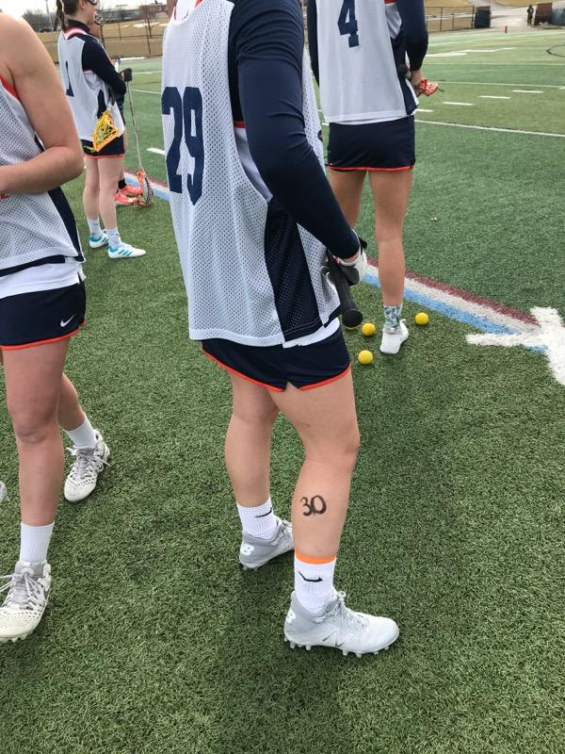
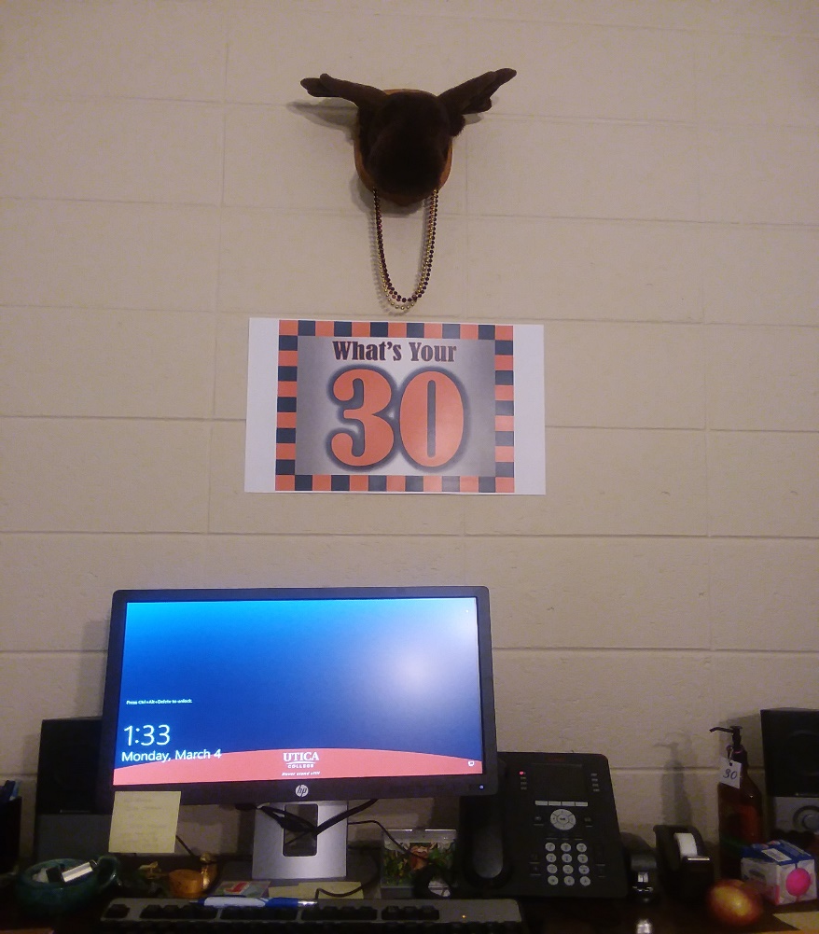
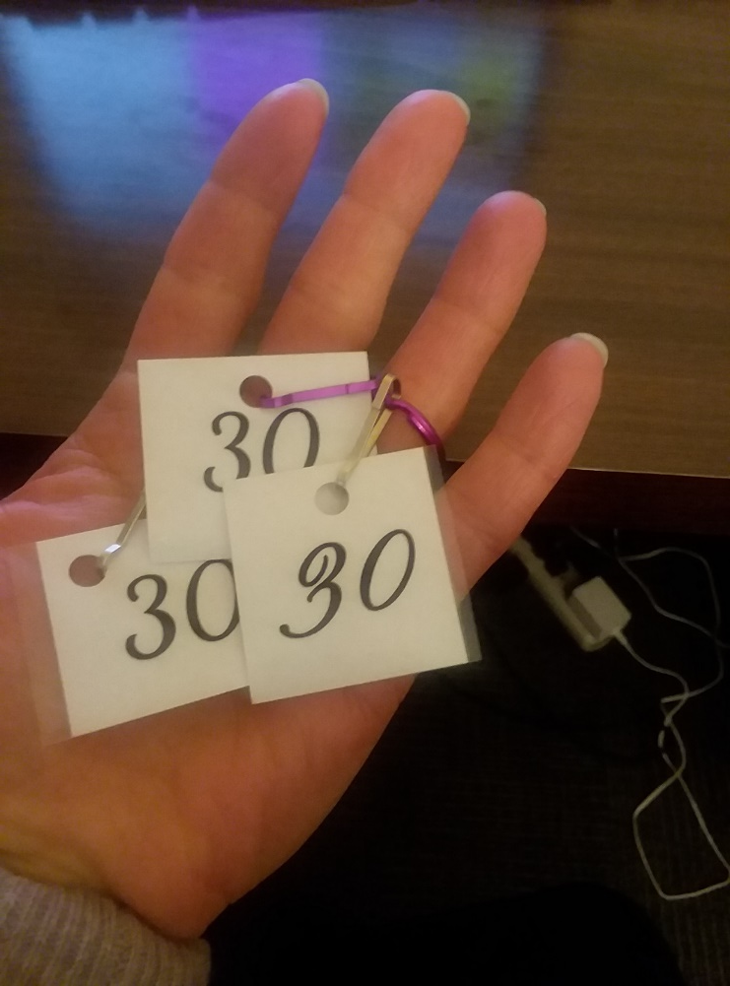
Week 5: Ruth Larson’s 30 Exercise
Provided as a team

Slide 29
Week 6: Process
What was it like when I asked you to make a list of 30 items?
What was it like to give feedback to teammates?
What was it like to receive feedback from teammates?
How to keep this in mind?

Slide 30
Weeks 7-9: Visualization
Week 7- General stress reduction visualization
Week 8- Self esteem based
Week 9- Sport specific (required some homework on my part)

Slide 31
Week 10: Debrief, feedback, post-test
What was helpful?
What did you like?
What would you change?
Heads up regarding survey being sent over email

Slide 32
How were coaches involved?
Some were more involved than others
When possible, I would include coaches on emails that I would send to the team reviewing information that was taught that week
Other coaches wanted to chat briefly after the workshop
Others preferred a phone call etc.

Slide 33
Other Outcomes
Offered to approximately 230 athletes/7 teams (100 were Football alone)
143 Student-Athletes chose to participate in the data collection portion; however, many more participated in workshop
Team’s in Fall showed an increase in Grit
Grit-TBD
Huge increase in referrals!

Slide 34
Results: Fall Team GPA

Slide 35
Spring Team GPA

Slide 36
Conference Outcome- Men’s/Women’s XC
 | 2013 | 2014 | 2015 | 2016 | 2017 | 2018
Men's XC
Empire 8 finish | 2nd | 5th | 2nd | 4th | 3rd | 1st
NCAA finish | 18th | 22nd | 18th | 15th | 21st | 19th
 | 2013 | 2014 | 2015 | 2016 | 2017 | 2018
Women's XC
Empire 8 finish | 4th | 5th | 5th | 4th | 1st | 1st
NCAA finish | NA | 26th | 23rd | 23rd | 13th | 14th

Slide 37
Winning Percentage- Men’s Soccer

Slide 38
Winning Percentage- Women’s Soccer

Slide 39
Winning Percentage- Women’s Basketball

Slide 40
Winning Percentage Women’s Lacrosse

Slide 41
Next Steps and Questions

