Slide 1
The Evolution of a Counseling Center: From Traditional to Triage
Beth Cholette, PhD, RYT
Clinical Director for South Village Counseling Services
Madeline Velázquez, LMSW
Triage Counselor Counseling Services
SUNY Geneseo

Slide 2
The presenters have no actual or potential conflict of interest in relation to this program/presentation.

Slide 3
Learning Objectives
Participants will demonstrate understanding of the difference between an intake-focused model of services versus a triage-based model.
Participants will be able to describe the current service model at their institution and compare to the model presented.
Participants will be able to identify the systematic benefits of a triage-based model.
Participants will be able to identify 1-3 ways to enhance or update services at their institution.

Slide 4
What We Did Before A.K.A “Back in My Day…”
1995-2010:
Client first contact = Intake appointment
3 FTE counselors, all conduct Intakes
Clients see Intake counselor for ongoing therapy

Slide 5
Starting to Evolve: First Attempt (2011-16)
Client first contact = MEETing Meet, Evaluate, Educate, Treat
How MEETings were more triage-like:
More frequent appointments available
Less forms for clients to complete upon arrival
Shorter appointments (still scheduled full hour, but 30-40 minutes with client)
Shorter summary report by counselor
Clients engaging in therapy referred for Intake appointment, usually with same counselor

Slide 6
Starting to Evolve: What Went Well
Decreased wait time for initial MEETing appointments (at least at first!)
Increased focus on single-session intervention (problem-solving)
Switching to a biweekly model for ongoing therapy allowed greater flexibility
Presenting utilization data to administration resulted in new FTE position (August 2013)

Slide 7
Starting to Evolve: Perils and Pitfalls
Decreased throughput (scheduling for therapy after initial appointment) despite improved input (initial MEETing session)
New FTE availability quickly outpaced by growing utilization numbers
Wait times for initial MEETing eventually increased from 2-3 days to 1-2 weeks
Student reluctance to follow through with off-campus referral recommendations

Slide 8
Continued Evolution: Why Change?
Perils and Pitfalls!
Increasing Utilization:*
16.1% increase in total number of counseling appointments (Fall 2015=983, Fall 2016=1141)
Areas of increase: Crises=92.7% Case Follow-Up=26.3% Intakes=2.8% Individual Ongoing=39.1%
*Based on SUNY Geneseo Counseling Services data,
Fall 2015 vs. Fall 2016

Slide 9
Continued Evolution: Why Change?, continued
National trends: Source: The Association for University and College Counseling Center Directors Annual (AUCCCD) Survey, July 1, 2016 through June 30, 2017 For schools that have 5001-7500 students:
Mean number triage appointments: 200 (454)
Medium number individual: 1698 (703)
Mean number crisis appointments: 106.8 (54)
Median number psychiatric: 184 (84)
(Parenthetical numbers based on Geneseo, Fall 2017)

Slide 10
Continued Evolution: Why Change?, continued
Increasing symptom severity: Source: American College Health Association-National College Health Assessment II (ACHA-NCHA II), Conducted at Geneseo Spring 2018
70% “Felt overwhelming anxiety”
57% “Felt things were hopeless”
47% “Felt so depressed it was difficult to function
15% “Seriously considered suicide”
12% intentionally injured (cutting, burning, etc.)
75% identified at least one life issue (academics, family, interpersonal, sleep, health, etc.) as being “traumatic or very difficult to handle” →56% reported dealing with 3 or more issues

Slide 11
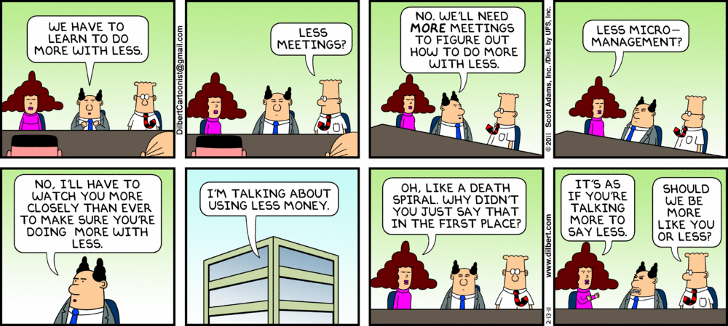

Slide 13
Becoming “Agents of Change”
Approval to add three new FTE lines in February 2016
Two of three FTE lines designated as “triage counselors” (a.ka. “jack of all trades”)
Plan to have two new triage counselors manage all initial triage, all walk-ins, all crises, all referrals—and pretty much anything else we could get them to do! ☺

Slide 14
Plan Versus Reality

Slide 15
So…
What do the
Triage Counselors REALLY do?

Slide 16
Prevention / Intervention / Postvention
Prevention
Coordinator of Health Promotion - Wellness Outreach
Triage Counselors as psycho-educators - Campus Outreach Programming and Initial Triage Appointments
Intervention
Triage Counselors provide Crisis Appointments
Short Term Counselors
Psychiatrist (triage does not refer directly to psychiatry)
Postvention
Triage Counselors provide Case Management:
Gap sessions
Post-Hospitalization Discharges
Referral from short term counseling to community based higher level of services

Slide 17
Single versus Dual
Triage Provisions
 | One On-Staff Triage Counselor | Two On-Staff Triage Counselors
Scheduling backup provisions | - | Yes
Ability to perform campus outreach combined with psycho-education | - | Yes
Ability to allot case management specific time | - | Yes
Resource building time | - | Yes
Semester end assistance with Brief Counseling Appointments | - | Yes
Pre-Triage Utilized | Yes | -

Slide 18
Pre-Triage / Purple Form
If a triage appointment time is not immediately available for a walk-in, client reviews this form and the Backup “On-Call” Counselor completes a 5-minute pre-screening for services.
By simply stating YES or NO, please let us know if any of the following items apply to your current situation:
Recent suicide attempt/increase/thoughts/plans
Self Injury within 24 hours
Thoughts of SI/HI
Concerned for safety of another
Recent harm to your person
Recent witnessing of violence
Death of a loved one
Hallucinations
Out of control recreational drug use
Need for hospital services

Slide 19
Defining Initial Care Level
 | Defined As | Appointment Time
Emergency | Active Mania, High Risk SI/HI, Severe Psychiatric Need, Special Referral for Assessment, Possible MHA needs, etc | Immediate Care
Crisis | Defined by the client or referral source as needing prompt services | Same Day to Next Day
On-Call | Request for initial counseling appointment | Within 48 - 72 Hours

Slide 20
Adhesive Time Managing of a 45-Minute Triage Appointment
8 Minutes: Client Completes Documentation (questionnaire, CCAPS)
2 Minutes: Verbal Confidentiality Disclosure
15 Minutes: Case Discussion/Event/Symptoms/Background/Goals
10 Minutes: Risk Assessment
5 Minutes: Psychoeducation/Intervention
5 Minutes: Referral and Documentation

Slide 21
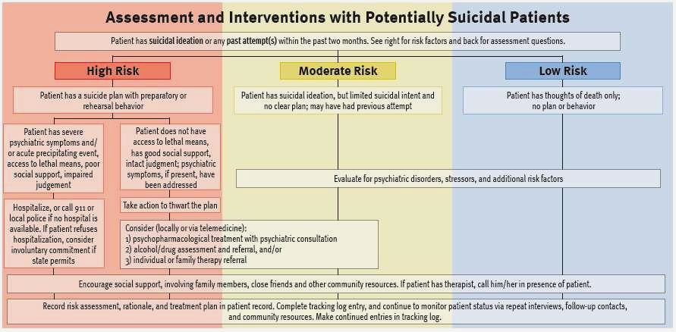
Triage Session Risk Assessment
Assessing current and past ideation or events
Self-Injurious Behaviors
Suicidal Ideation/Attempts
Homicidal Ideation/Attempts
Eating Disorder Thoughts/Behaviors

Slide 22
Benefits of Dedicated Triage Counselor(s)
Quicker access to care for first-time clients
Higher utilization by those who previously did not access services (largely due to decreased wait times)
Rapid screening of all new clients
Greater dedication to client’s presenting needs
Improved referrals with limited resources, including faster connections and better follow-up
Increased recognition of high acuity serviced
Higher client satisfaction with services
Improved overall perception of services

Slide 23
Hiring for Essential Skills
Clinical Management Skills
Rapid client sorting based on acuity
Rapid assessment for appropriateness of short intervention
Ability to provide Brief Timed Interventions
Strong Counselor/Client matching
Comfort providing Pre-Intake Diagnostic Assessment
Comfort utilizing Motivational Interviewing, particularly when referring clients to community for higher level of care
Ability to de-escalate clients in crisis
Ability to manage MHA referrals while maintaining safety protocols

Slide 24
Hiring for Essential Skills, cont.
Business Management Skills
Ability for quick decision-making
Appointment time management
Ability to help client create and accept a strong disposition plan
Strong follow up with referrals
Generalist Skills
Ability to represent and manage Equality/Equity
Very broad knowledge and quick delivery of psychoeducation
Burn Out Prevention Skills
Ability to manage repeated crisis with high level of Self-Care

Slide 26
Smooth Beginnings
Logistics
Triage situated in front of center
Triage offices next to Clinical Director
System Change Buy-in
Educate existing professional staff on change to a new Triage Model
Evaluation and Supervision
Schedule seperate supervision time (Triage Counselors/Clinical Directors)
Assess Triage as a separate function (update departmental policies, QA, etc.)

Slide 27
Promoting the Approved Triage Model
Campus department heads are introduced to upcoming system by Counseling Director
Upon hire, new Triage Counselors are introduced to staff and faculty
Triage Counselors meet with local community providers via:
Hosting Meet and Greet on campus
Onsite visits to community agencies
Memorandum of Understanding (MOU) with hospitals and other large agencies

Slide 28
Any Questions? Follow-up Questions/Comments: (may also request copy of slideshow)
Beth: cholette@geneseo.edu Madeline: velazquez@geneseo.edu

